Slide 1
BCCNM LPN/RN Registration Renewal 2022
About 2022 LPN/RN Renewal:
Opens February 1, 2022
Must be completed by March 31 @ 1630
RN practice year is April 1, 2022 - March 31, 2022
Fees: ≈ $530
Liability $72 - $92, Association Membership $42
January 31, 2022

Slide 2
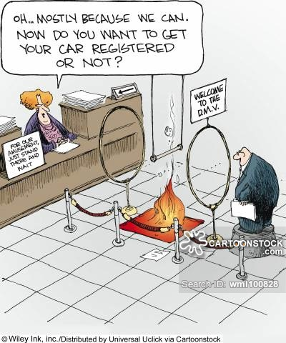
How to Renew: takes ≅ 30 – 60 minutes
Update Employment history / Contact info etc.
Provide information about any criminal charges or convictions over the past year
Consent to a criminal record check (if applicable)
Report Practice hours
Meet Quality Assurance requirements
Acknowledge you have read and understood all of the consent and declaration requirements
Pay fees $$$

Slide 3
Quality Assurance Activities
Registered Nurses:
Meet minimum practice hours (1,125 hrs over the past 5 years)
Complete a self-assessment or your practice
Seek and receive peer feedback
Create and implement a professional development plan based on their self assessment and peer feedback
Evaluate the effect of last year’s professional development on their practice

Slide 4
Self Assessment Tools
BCCNP Self-Assessment Questionnaire
online during renewal
Cape Tool: _____________________________
Professional Development Plan Template
______________________________________
______________________________________

Slide 5
Peer Feedback
Selecting a Peer
- Be creative in choosing a peer to help you
assess practice.
- Choose someone whose opinion you respect
and judgement you trust.
Asking for Feedback
- Briefly indicate what you would like to cover and why its important.
- Discuss and review some of your practice experiences.
- Use your self assessment to guide the discussion.
- Be specific about your abilities, strengths, and areas for growth.
- You may want to share ideas about learning activities.

Slide 6
Peer Feedback
3. Receiving Feedback
- Prepare the information from your self assessment so that you can be specific.
- Take time to listen, understand, and consider what is being said.
- Ask questions and be curious about how your peer sees you.
- Ask for suggestions on how to enhance your practice and grow professionally.
- Two questions to keep in mind:
1. What do I do best?
2. Is there some aspect of my practice I can improve?
- Show appreciation for the feedback you receive.

Slide 7
Peer Feedback
4. Giving Feedback
Direct your feedback toward what is specifically asked for to meet your peer’s needs.
Be specific, supportive, and constructive in your comments.
Remember to be attentive to feelings and non-verbal cues.
Be thoughtful in your comments and tone.
Create an opportunity for exploring practice needs, strengths, and ideas.

Slide 8
Professional Development Plan
Reflect on your self assessment and peer feedback to choose a learning goal:
What do I need to learn?
What do I want to learn?
What goals do I have for my professional development?
Choose the BCCNP Professional Standard that relates to your learning goal.
- Standard 1: Professional Responsibility and Accountability
- Standard 2: Knowledge Based Practice
- Standard 3: Client-Focused Provision of Service
- Standard 4: Ethical Practice

Slide 9
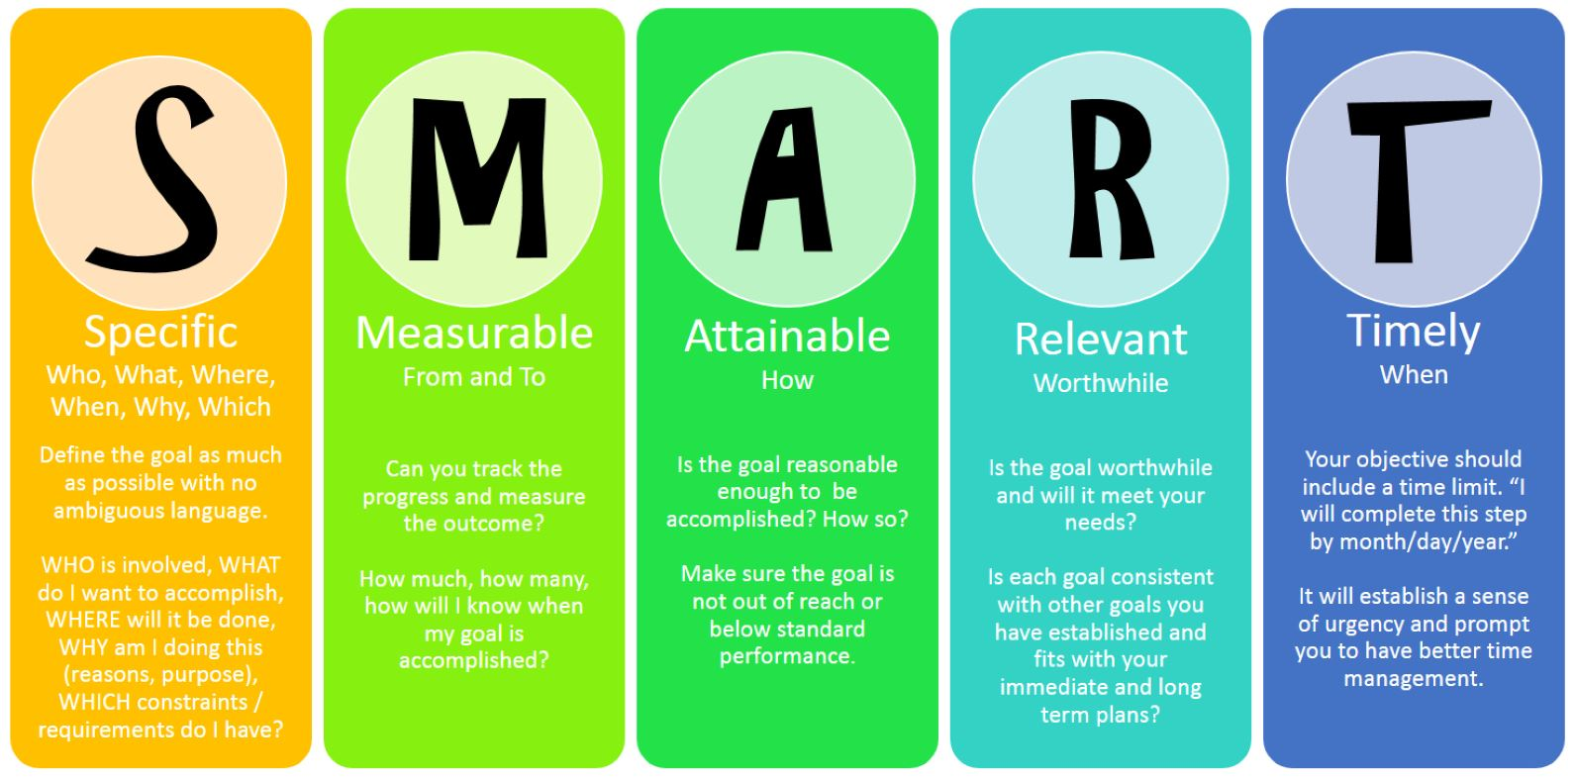
Professional Development Plan
3. Using SMART goals, plan:
- How will I achieve my learning needs and goals?
- What is the best way to document my plan?
- How will I measure my success?

Slide 10
Professional Development Activity Ideas:
Review and discuss case studies
Attend conferences, workshops,
in-service education, late start Tues, SIMS
Take an online or in person course
Self directed research from journal articles or electronic resources
Organize a meeting to address issues in your workplace
Ask some “in the moment” support from your CNE, Clinical mentor, New Grad Educator

